Slide 1

PEDESTRIAN DETECTION IN BAD WEATHER CONDITIONS
Internal Guide:
Dr. M. Neelakantappa
Associate Professor
Department of Information Technology
Team no. 17
N.Naveen Reddy 1602-20-737-086
C.Narendra Sai 1602-20-737-084
B.Hemanth Reddy 1602-20-737-073

Slide 2
Agenda
Abstract
Literature Survey
Methodology
Problem Statement
Dataset
Architecture
Metrics
Results
Conclusion
Future Scope

Slide 3
Abstract
Pedestrian detection systems are crucial for ensuring road safety, but their efficacy can be compromised in adverse weather conditions such as rain, fog, or snow
Existing pedestrian detection models often falter in mild weather, leading to increased risks of accidents.
By enhancing pedestrian detection capabilities in poor weather, this project contributes to safer autonomous driving systems and mitigates the risks associated with adverse weather conditions on roadways.

Slide 4
Problem Statement
Developing an efficient pedestrian detection system capable of accurately detecting pedestrians in adverse weather conditions using Convolutional Neural Networks.
The objective is to reduce the challenges posed by poor visibility due to poor weather, thereby enhancing pedestrian safety and reducing the risk of accidents in such conditions.
The proposed system should demonstrate robustness, high detection accuracy, and real-time performance across various weather scenarios, ultimately contributing to the advancement of autonomous driving technology and pedestrian safety measures.

Slide 5
Literature Survey
S No | Title | Author | Content
1 | Pedestrian detection based on improved Faster RCNN algorithm | Xiaoqian Yu, Yujuan Si, Liang Li | RCNN on Caltech and INRIA pedestrian datasets
2 | Pedestrian Detection in Rainy Weather | Divya Seshadri, Indhuja, Amutha R | YOLOv3 (You Only Look Once) with ZUT dataset

Slide 6
Literature Survey
S No. | Title | Authors | Content
4 | Histograms of Oriented Gradients for Human Detection | Dalal N, Triggs B | HOG on CityPersons Dataset
5 | Deep Learning-Based Pedestrian Detection in Autonomous Vehicles: Substantial Issues and Challenges | Sundas Iftikhar, Zuping Zhang, Muhammad Asim | EuroCity Datset using Deep Learning Approaches

Slide 7
Implementation:
Dataset Collection
Data Transformation
Data Annotations
Training the Model
Validating the Model
Object Detection

Slide 8
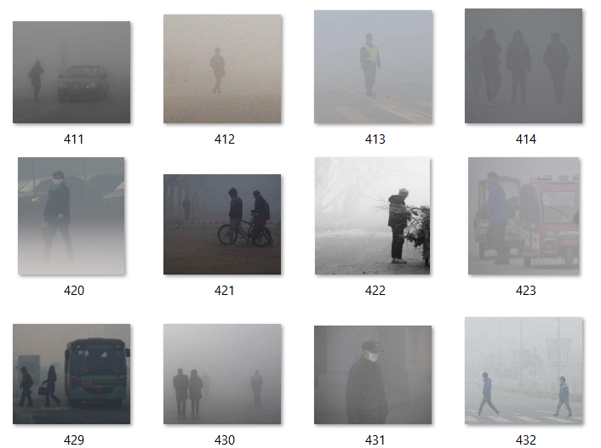
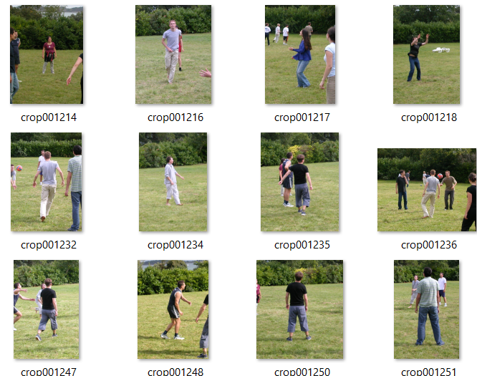
Datasets
INRIA Dataset
Hazy Weather Dataset

Slide 9
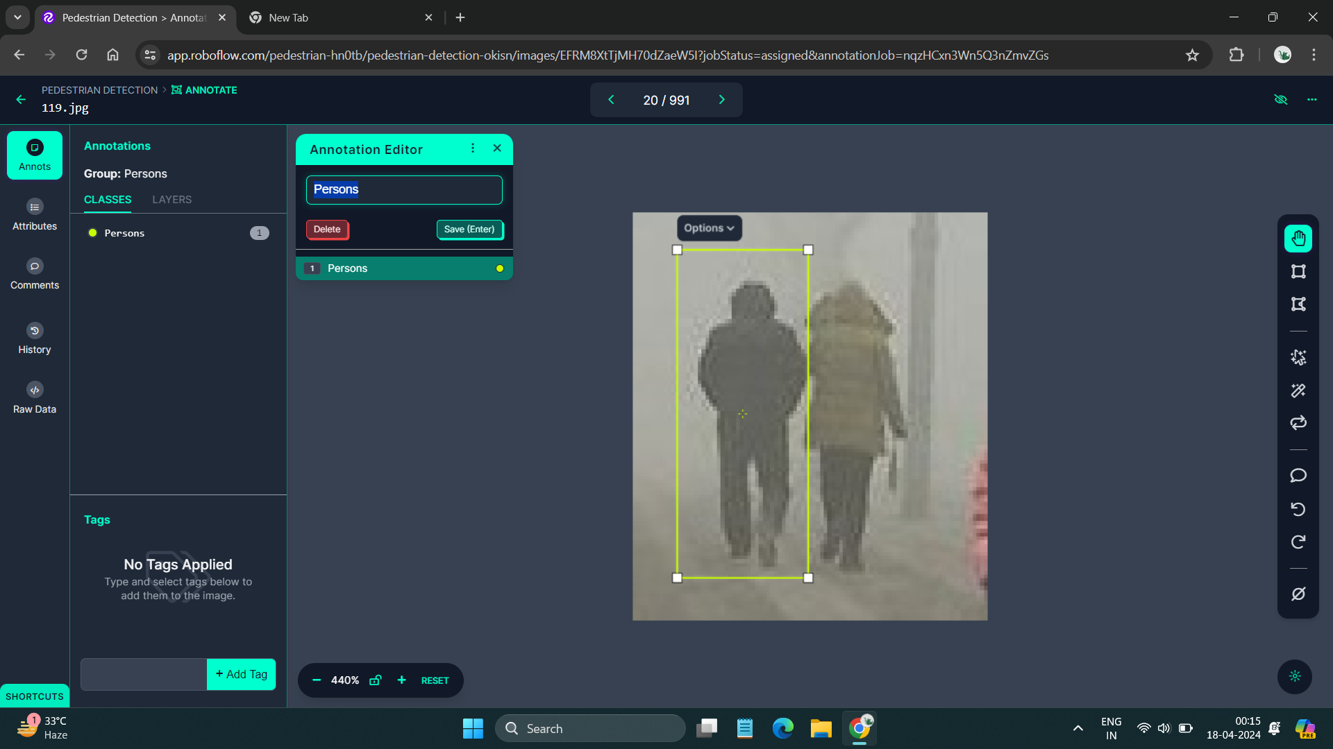
Data Annotation
Annotating the Data in Roboflow

Slide 10
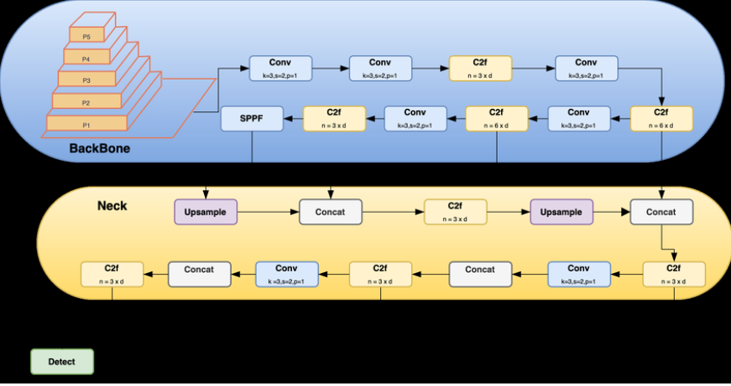
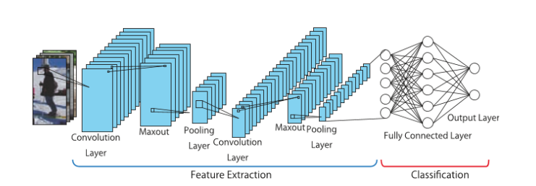
Architecture:

Slide 11
Evaluation Metrics
Metrics | Resnet-50 | YOLO V8 | Roboflow
Accuracy | 85% | 87% | 91%
Precision | 0.87 | 0.90 | 0.93
Recall | 0.83 | 0.87 | 0.85

Slide 12
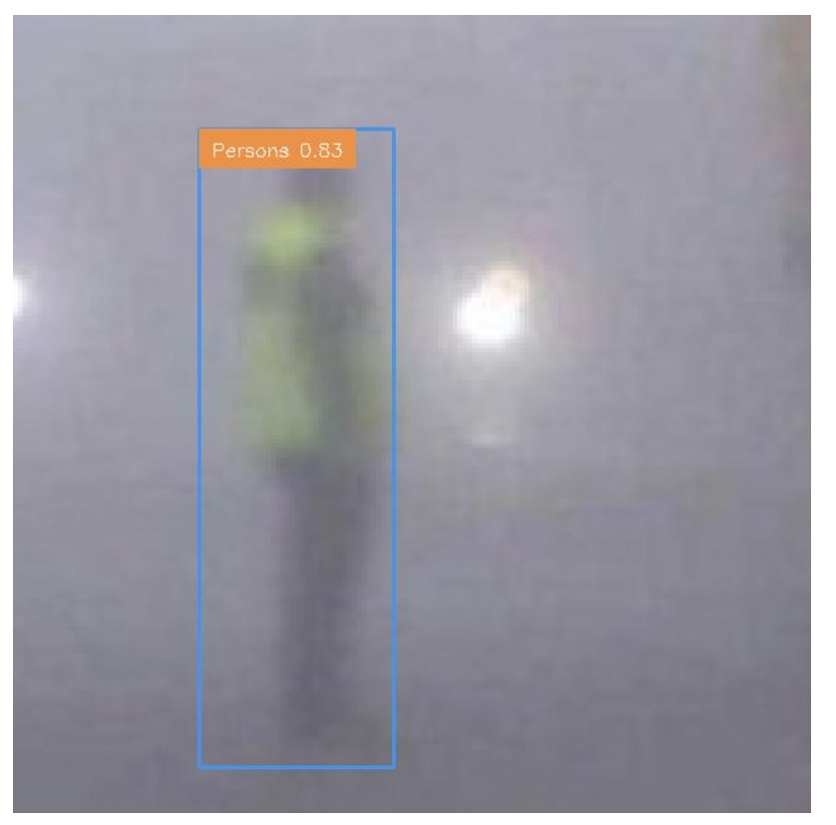
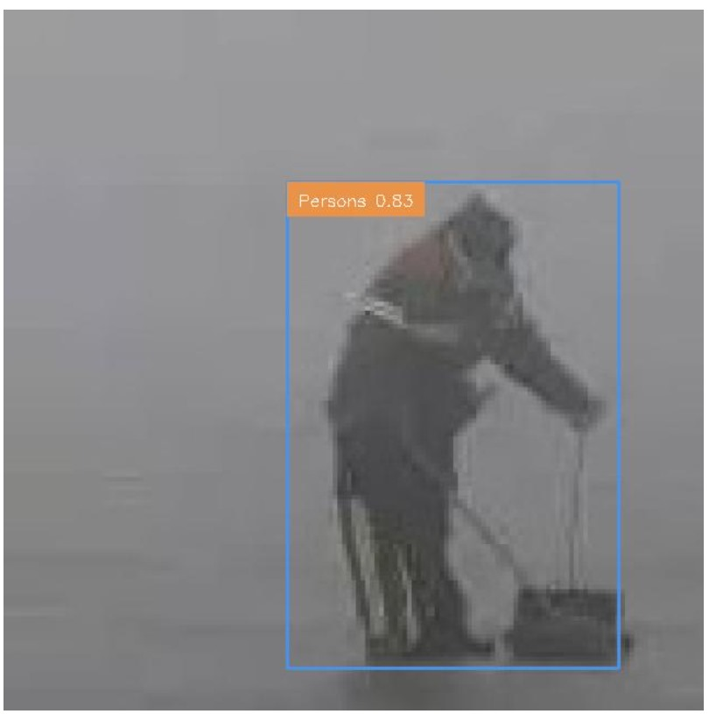
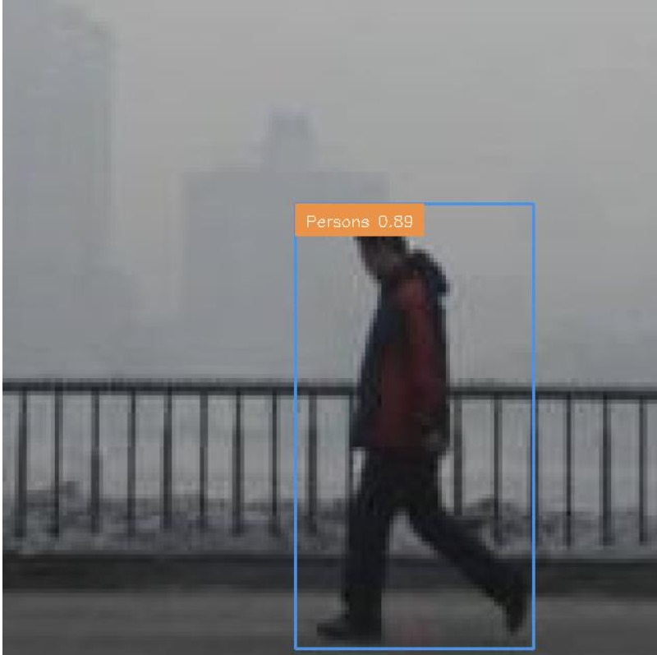
Results

Slide 13
Future Scope:
In our next stage, we'll expand our dataset to include different kinds of weather like snow, rain, fog, and situations where there is Inclement weather
Furthermore, we are dedicated to improving the effectiveness of our system by using the latest algorithms and optimization methods.
Moreover, our future endeavors will focus on seamless integration with transportation infrastructure and vehicles.

Slide 14
Conclusion
In conclusion, the implementation of CNN and the YOLO algorithm has showcased promising advancements in pedestrian detection, particularly in adverse weather conditions.
Our Future research should focus on enhancing the robustness and reliability of detection algorithms, leveraging advancements in Computer Vision.
By addressing these challenges, we can strive towards a future where pedestrian safety is ensured regardless of weather conditions, ultimately saving lives and fostering a safer transportation environment for all.

Slide 15
References:
P. Tumas, A. Nowosielski and A. Serackis, "Pedestrian Detection in Severe Weather Conditions," in IEEE Access, vol. 8, pp. 62775-62784, 2020, doi: 10.1109/ACCESS.2020.2982539
D. M. Gavrila and S. Munder, “Vision-based pedestrian protection: The PROTECTOR system,” in Proc. IEEE Intelligent Vehicle Symposium, IV2008, Parma, Italy, June 2008
D. S. M, I. U. S and A. R, "Pedestrian Detection in Extreme Weather," 2021 Fourth International Conference on Electrical, Computer and Communication Technologies (ICECCT), Erode, India, 2021, pp. 1-6, doi: 10.1109/ICECCT52121.2021.9616723.

Slide 16
THANK YOU

